Slide 1
Hyperparameter Project
Group DB01
Team Members:
Aniruddha Joshi
Amey Babar

Slide 2
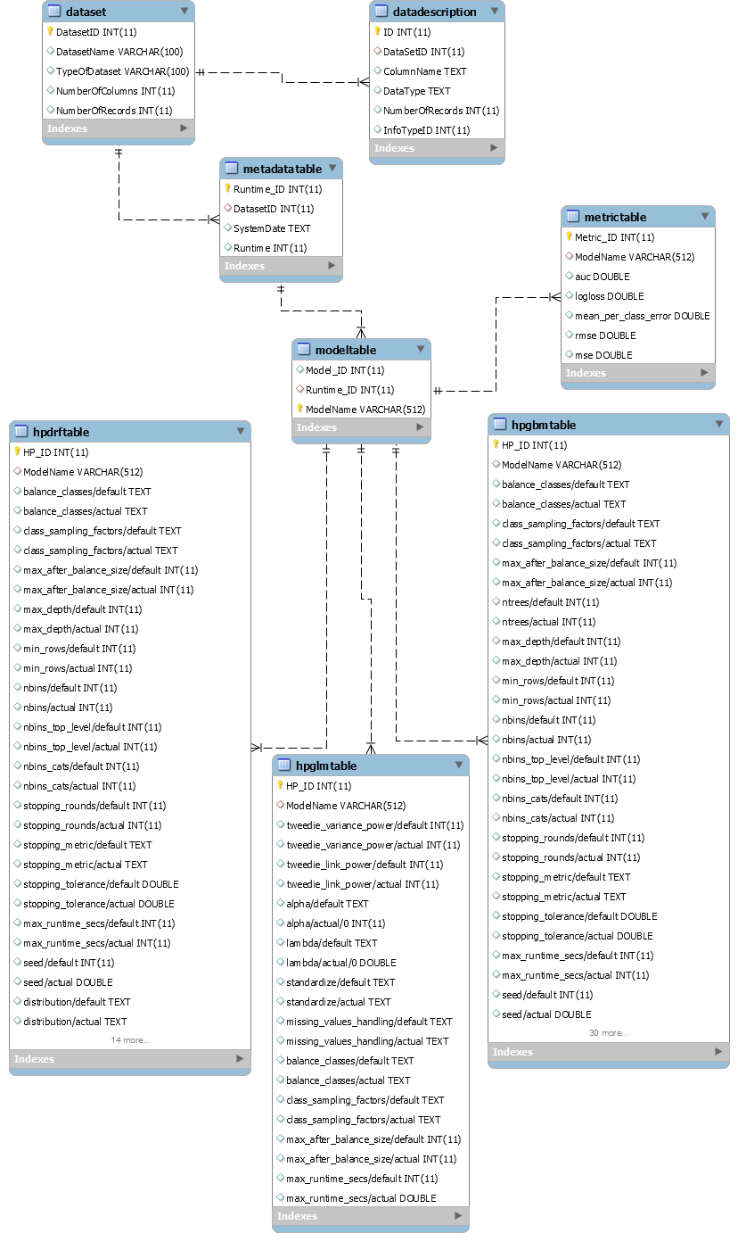
ER Diagram

Slide 3
Impact of HbA1c Measurement on Hospital Readmission Rates
Our Target Column is Readmitted, where we will be using classification model to analyze the number of patients who are readmitted within 30 days.
Among the different cases of readmittance we will concentrate on diabetes encounters.

Slide 4
Completed work
Abstract
Conceptual Model
ER Diagram
Normalization
Physical model
Usecases
Views

Slide 5
Remaining work
2 Functions per team member
Make the documentation/report
Make portfolio

